Slide 1
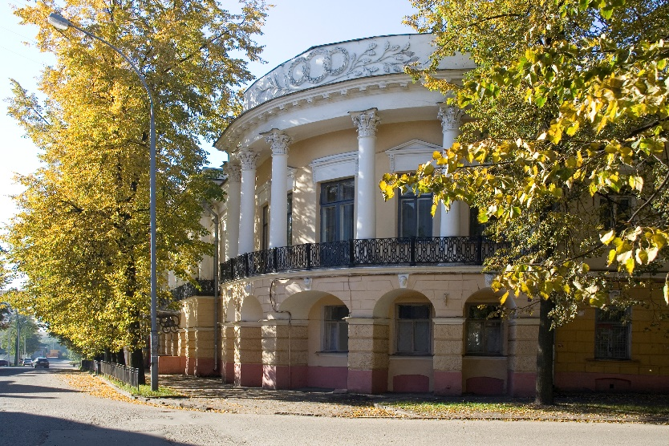
Yaroslavl State Pedagogical University named after K.D. Ushinsky

Slide 2
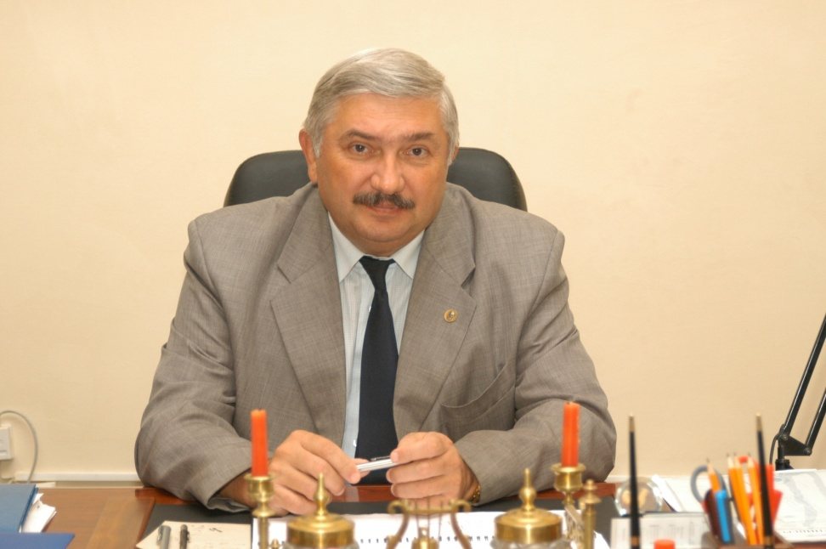
Vladimir Vasilevich Afanasev

Slide 3
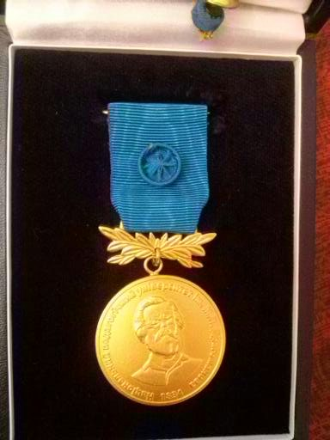
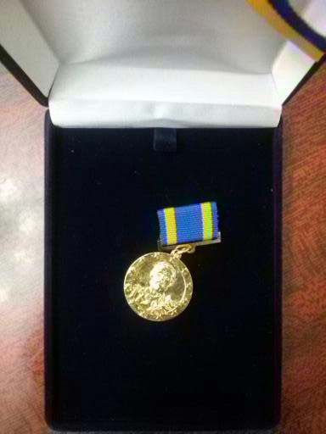
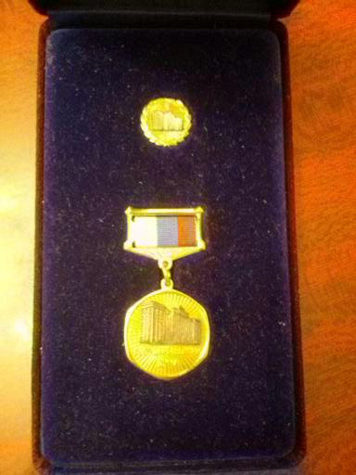
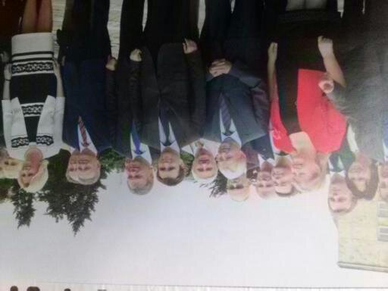

Slide 4
It occupies the first place among the best Pedagogical Universities in Russia
http://www.ulizza.ru/novosti/yaroslavl-sobytije-nedeli-jagpu-im-ushinskogo-vozglavil-rejting-vostrebovannosti-gumanitarnyh-vuzov-rf/#.Vqiop5qLQ_4

Slide 5
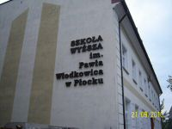
International Collaboration
YSPU collaborates with universities, scientific and cultural centres and organisations of 35 countries of the world.

Slide 6
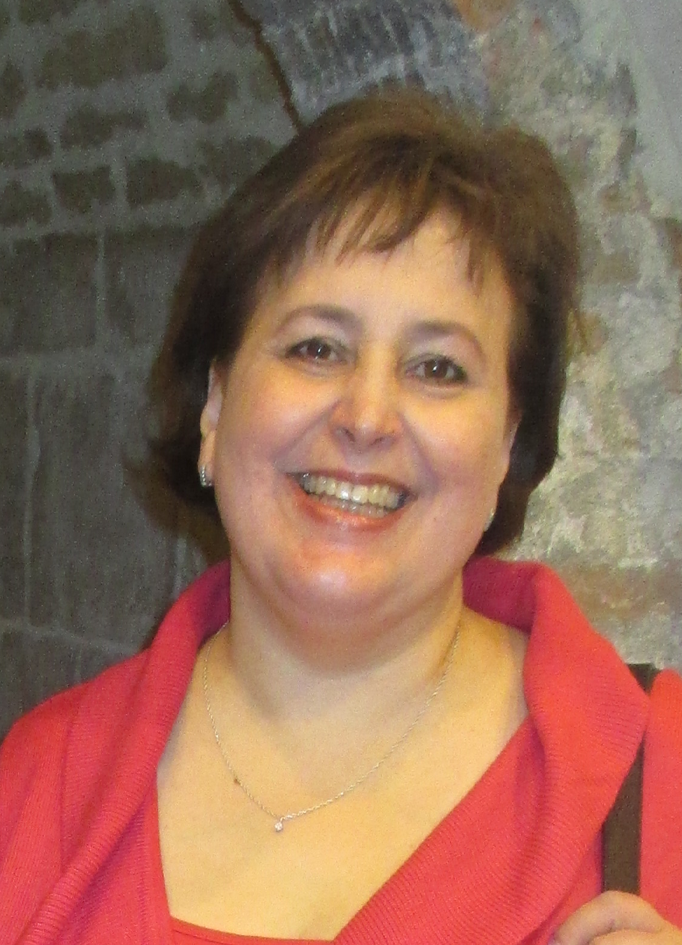
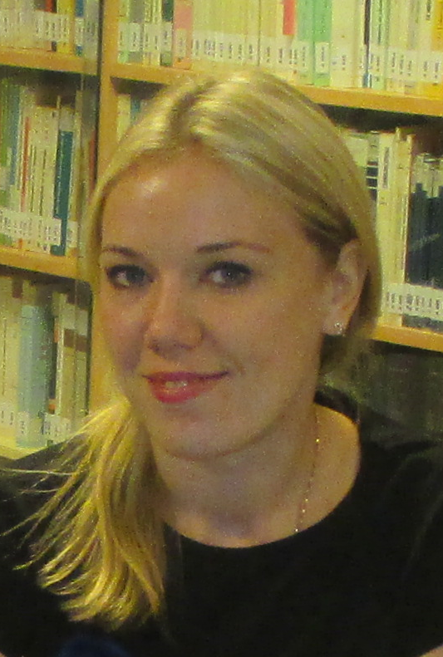
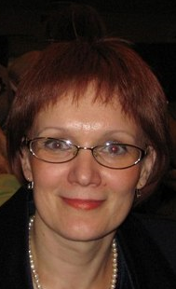
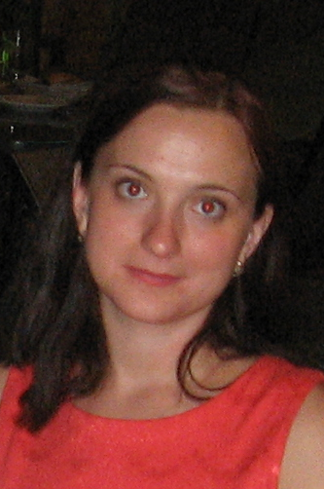
Tempus Project

Slide 7
Master Programme
 |  | Directed learning | Independent learning | Assessment
Practical Course of Communicational Culture | English Language Improvement | 135 | 297 | 144
Pedagogy and Psychology in Higher Educational Establishment | Age Appropriate Language Pedagogy | 18 | 54 | 36
Theory and Methods of Teaching Foreign Languages | Foreign Language Teaching Methodology | 36 | 72 | 36
Modelling of Training Process | Technology and Language Teaching | 36 | 108 | 36
Modernization of Language Teaching | Course Design and Evaluation | 18 | 54 | -

Slide 8
Information-gathering and trainer training
Design of master’s programme and preparation of materials
Initial delivery of master’s programme

Slide 9
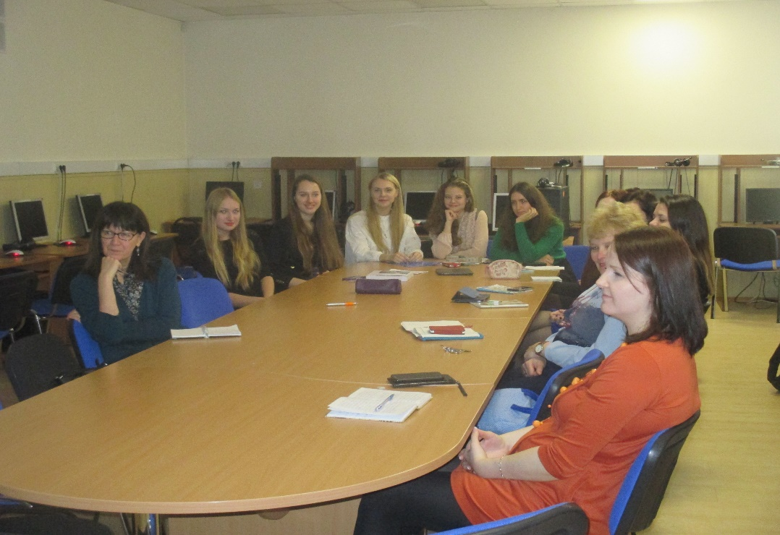
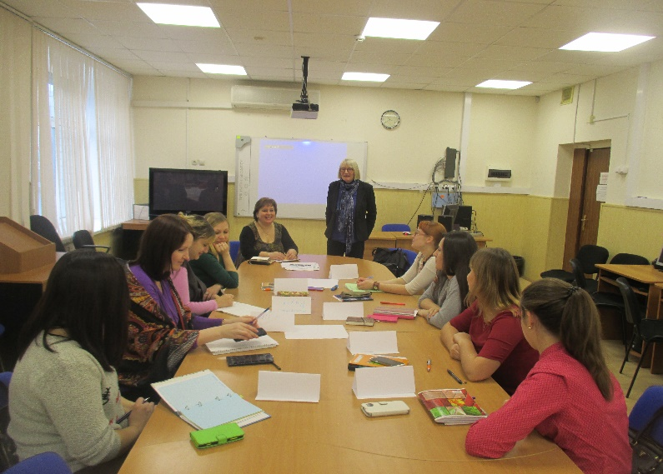
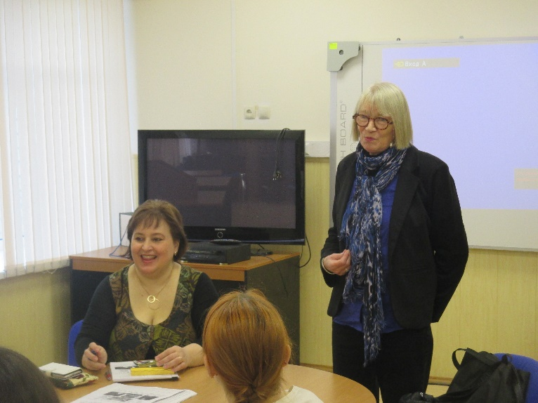
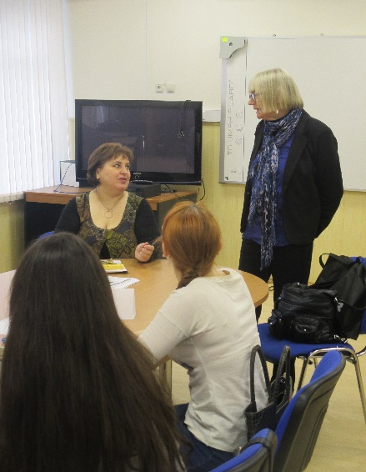
Co-teaching Sessions

Slide 10
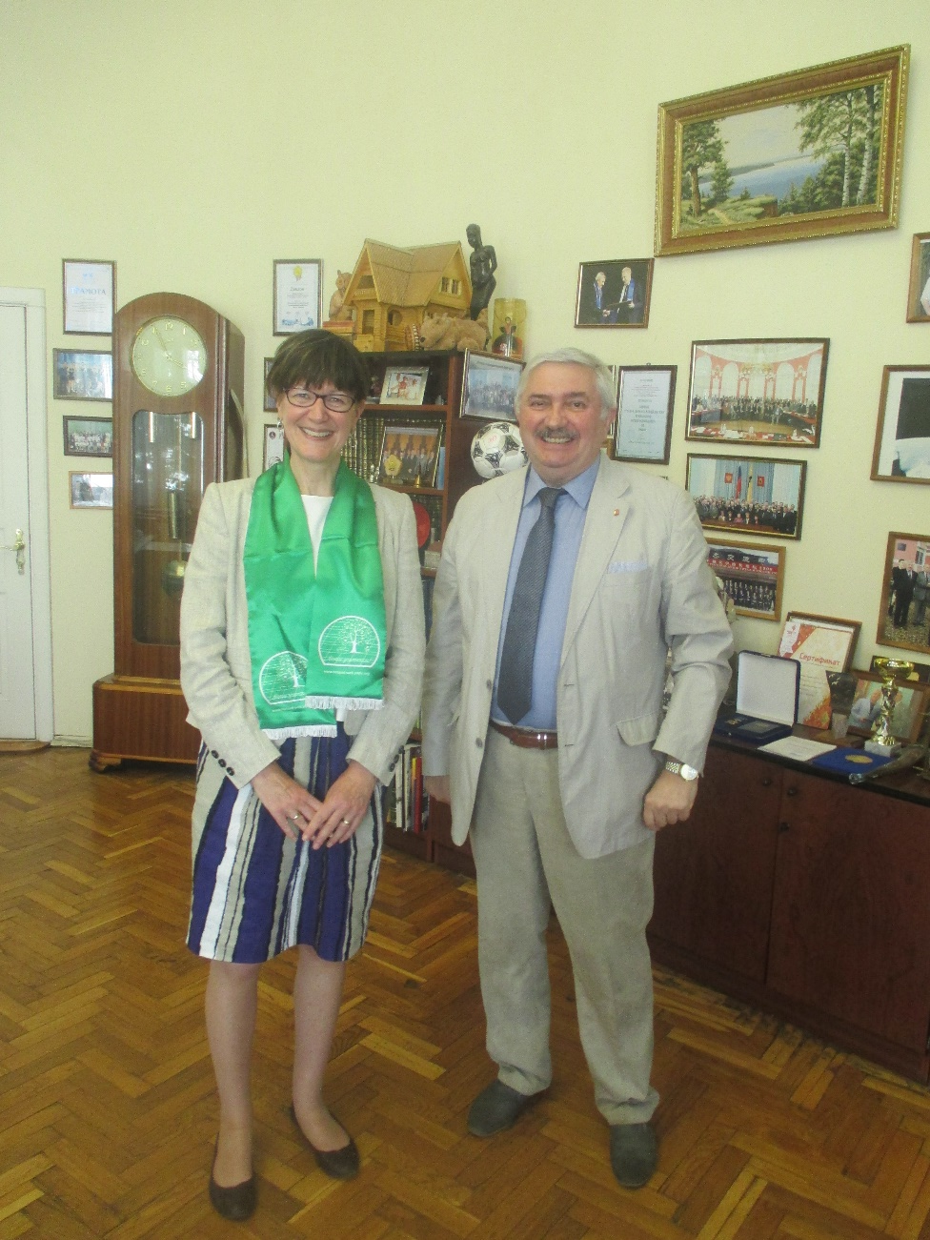
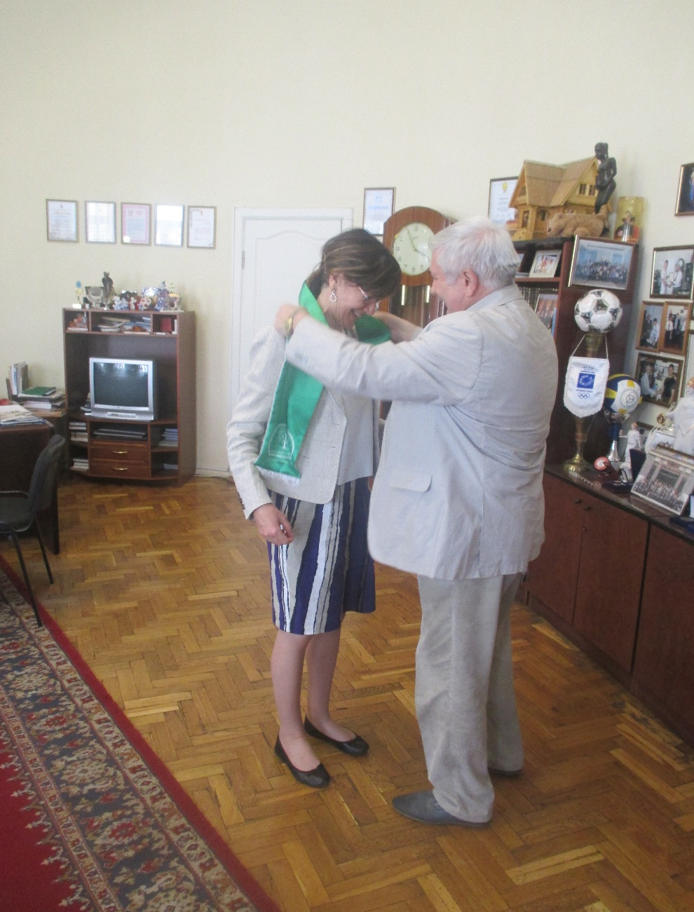
Meeting with the Rector

Slide 11
Dissemination

Slide 12
Thank you for your attention!

