Slide 1
REPUBLIC OF UZBEKISTAN MINISTRY OF HIGHER AND SECONDARY SPECIALIZED EDUCATION

Slide 2
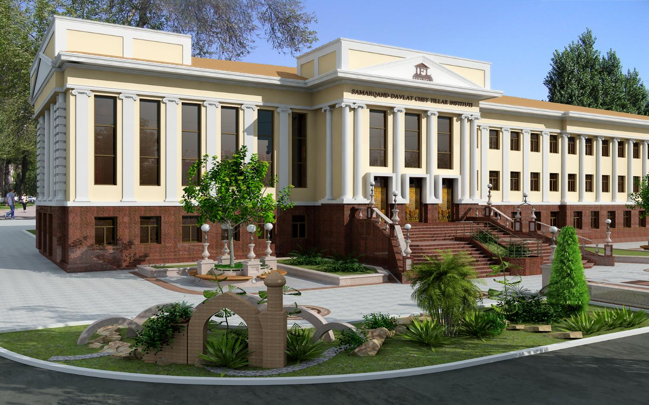
SAMARKAND STATE INSTITUTE OF FOREIGN LANGUAGES

Slide 3
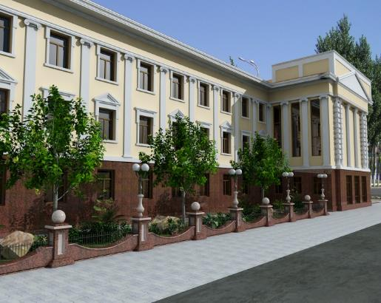
Samarkand State Institute of Foreign Languages was founded on November 8, 1994. SamSIFL is known as one of the leading language teaching institutions in preparing specialists in many foreign languages. Our Institute became one of the exemplary institutions, which successfully promotes foreign language specialists not only in Samarkand, but also in the whole of Central Asia.

Slide 4
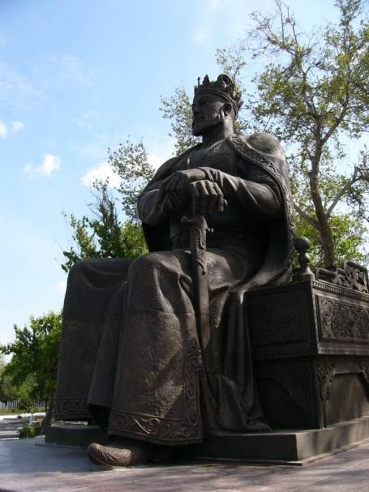
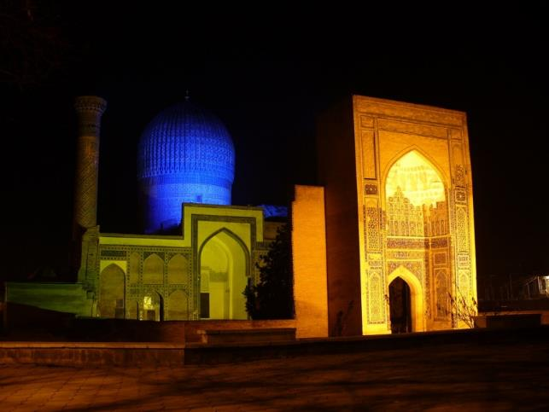
SamSIFL is situated in the centre of Samarkand city just opposite to the monument to the Great Amir Temur and also his mausoleum Guri-Emir.

Slide 5
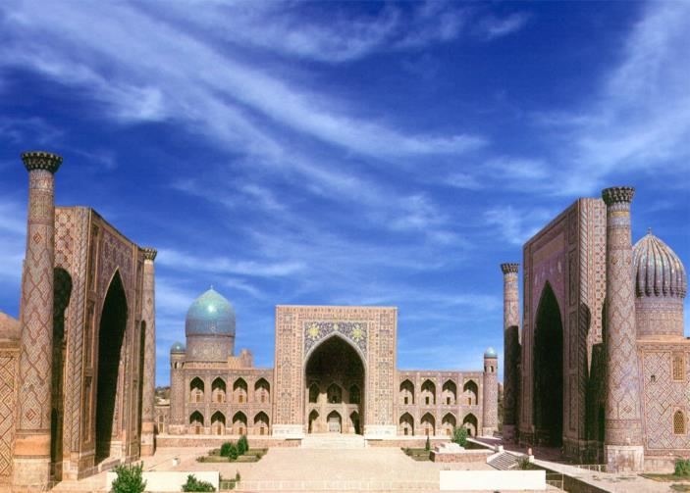
Samarkand is a pearl of the East which has a history of more than 2750 years. Our city is the contemporary of such ancient cities as Rome, Athens and Babylon. It was famous with the name “The land of scientists” in the European sources and as “Treasure of the East” in the Arabic manuscripts. Since ancient times Samarkand was very attractive with its individual beauty and splendor. That’s why the great statesman Amir Temur made it the capital of his enormous empire. Being on the intersection of caravan routes of the Silk Road, Samarkand was not only the center of trade and economy, but also the point of exchanging culture, traditions and national properties among the different nations of the world.

Slide 6
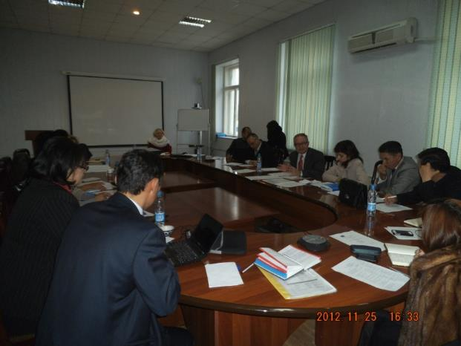
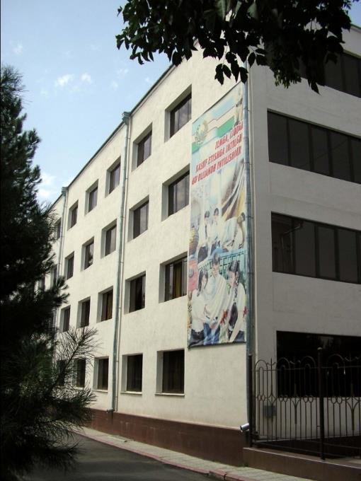
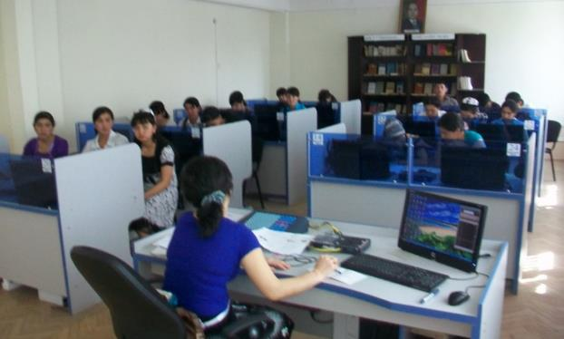
There are 3 faculties and 10 directions at SamSIFL
The English Philology Faculty
The English Language and Literature

Slide 7
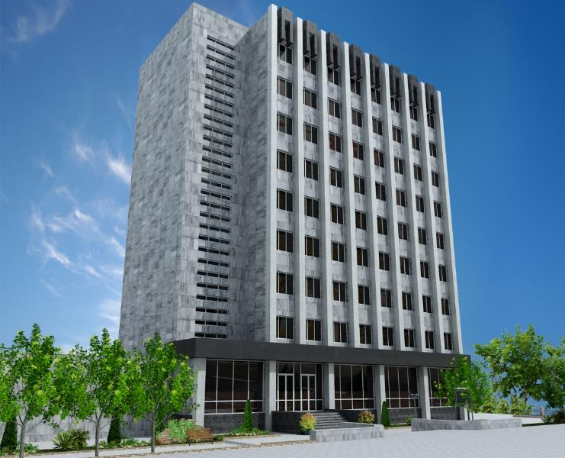
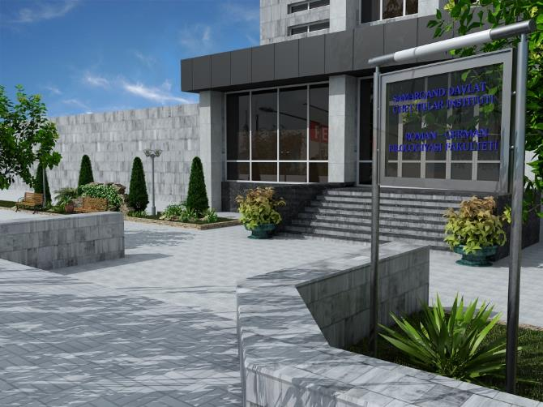
Roman-German Philology Faculty
The German Language
The French Language
The Italian Language
The Spanish Language

Slide 8
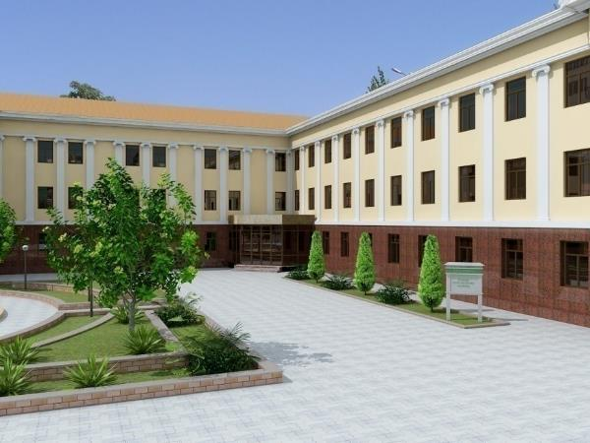
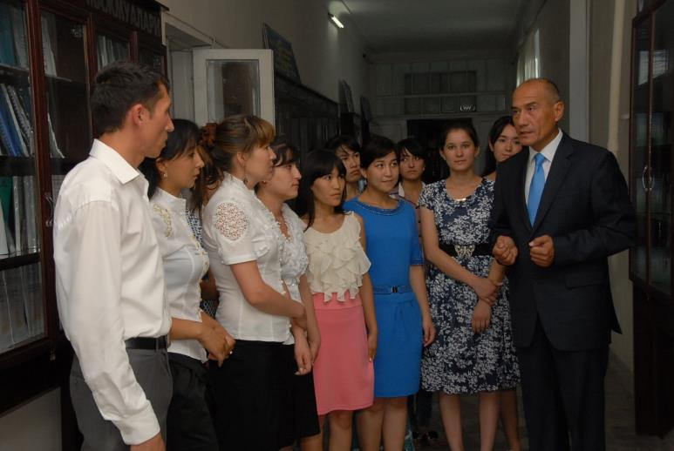
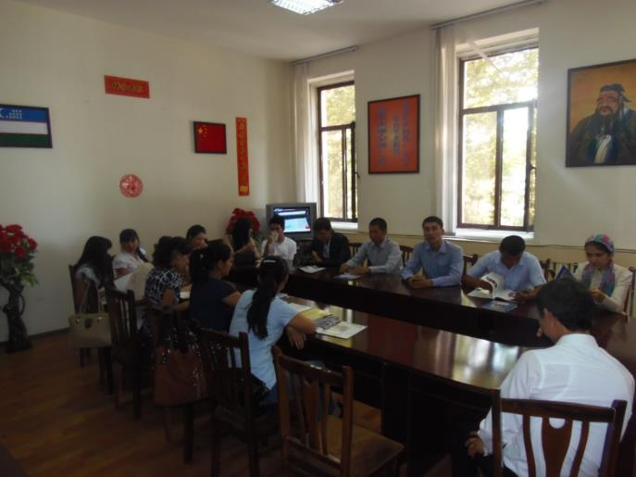
Translation Faculty
Translation Theory and Practice
The Korean Language
The Chinese Language
The Japanese Language
The Arabic Language

Slide 9
Departments (Chairs) of SamSIFL
Phonetics of the English Language
History and Grammar of the English Language
Methods of Teaching English
Lexicology and Stylistics of the English Language
World Literature
German Philology
Phonetics and Grammar of the German Language
French Philology
Phonetics and Grammar of the French Language
Translation Theory and Practice
Languages of Asian Countries
Theoretical Linguistics and Oriental Languages
Social Sciences
Pedagogics and Psychology
Informatics and Information Technology
Physical Training and Ecology

Slide 10
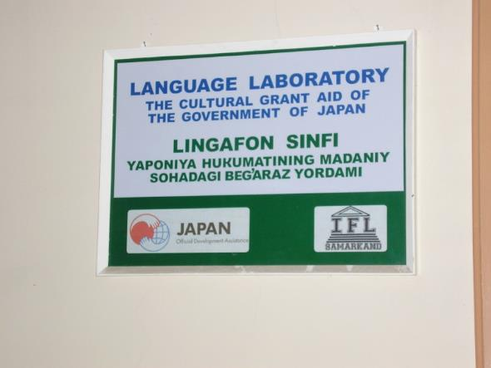
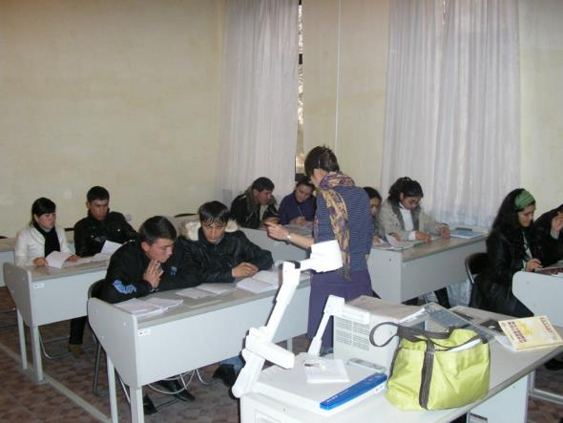
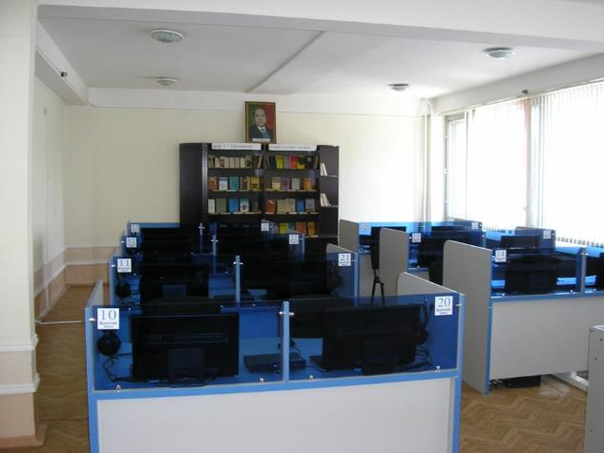
Currently, there are more than 2200 BA students including 7 foreign students, 160 MA students studying at the institute.
18 Doctors of sciences, professors, 77 PhD degree holders, 290 teachers, as well as over 15 foreign specialists teach at the institute.

Slide 11
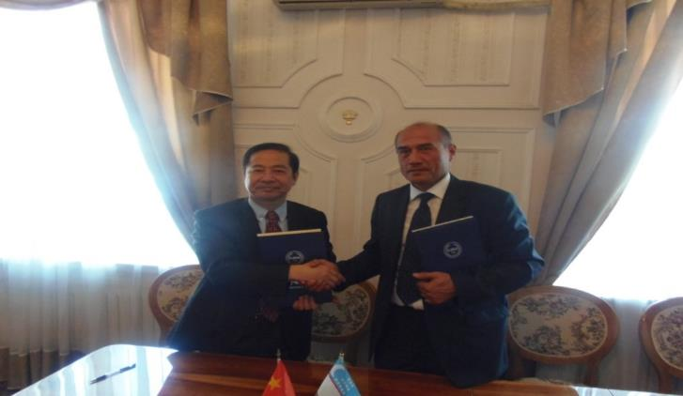
SamSIFL has been doing its utmost to establish mutually beneficial cooperation links with international organizations and higher educational institutions in many countries of the world since its foundation in 1994. Our collaboration with these organizations covers the spheres of research, education and culture.

Slide 12
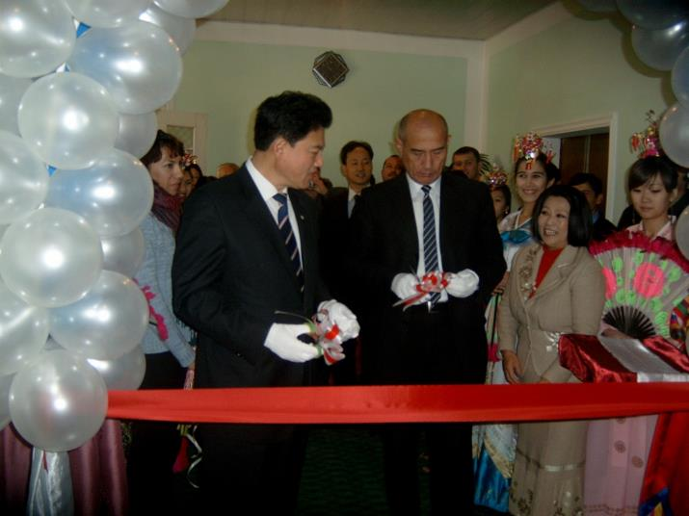
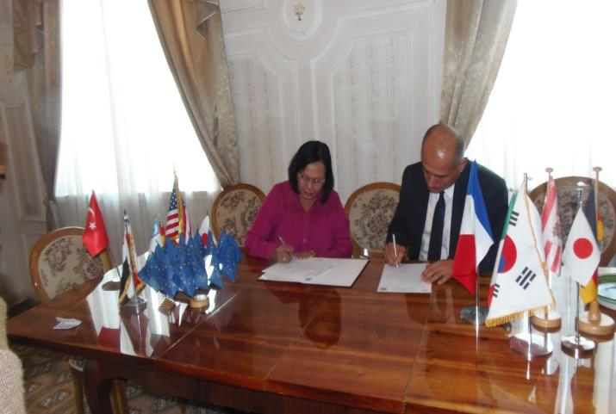
The Institute has signed about 50 Agreements on scientific and scientific - technical cooperation with higher educational establishments, international organizations and scientific centers of foreign countries of the world. Within the framework of mutual cooperation agreement with the universities programs the scientific-research works are realized; their results are published in the joint scientific editorials. Cooperation with universities of Russian Federation, Germany, France, Italy, Spain, Malaysia, South Korea, Japan, China, Egypt, UK, USA, and Kazakhstan is developing actively.

Slide 13
Besides, the Institute closely cooperates and participates in the work of noncommercial organizations and associations. Participation in the work of such international organizations as the British Council (BC), German Service of the Academic Exchange (DAAD), Goethe, TEMPUS, JICA, KOICA, JSV and others is especially making more active lately.

Slide 14
SamSIFL
London School of Business and Finance, United Kingdom
(Great Britain)
London Metropolitan Institute
(Great Britain)
Tsukuba University
(Japan)
Prefecture Fukuoka
(Japan)

Slide 15
SamSIFL
Moscow State Linguistics University
Russia
Chelyabinsk State University
Russia
Johannes Gutenberg University Mainz
(Germany)
Association of Spanish Language Teachers of Europe (АЕРЕ)
(Spain)

Slide 16
Korea
Chonnam national university
Chosun University
Dongguk University
Changwon National University
Pukyong national university
Chonbuk National University
Chungju National University
Korean National University of Transportation

Slide 17
China
Confucius Institute
Shanghai International Studies University
Xinjiang Pedagogical Institute
Xinjiang Agricultural University

Slide 18
SamSIFL
Gunadarma University the Republic of (Indonesia)
Sekolah Tinggi Teknik Miltimedia Univerisity
(Indonesia)
Universiteti Pendidikan Sultan Idris
(Malaysia)
Kazakhstan University of International Relations and World Languages

Slide 19
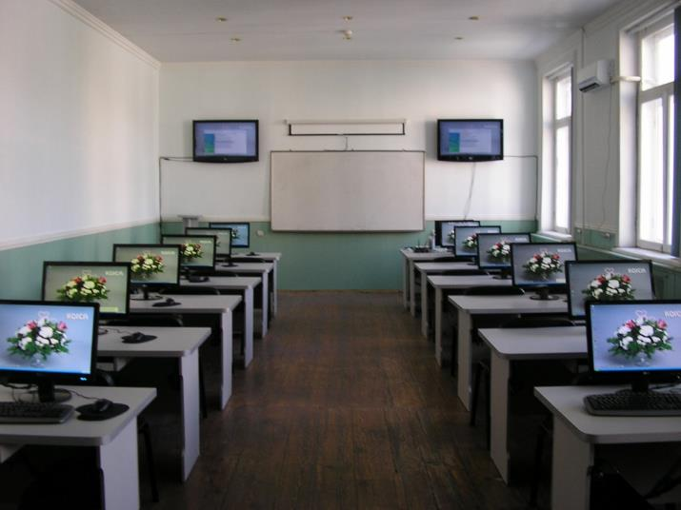
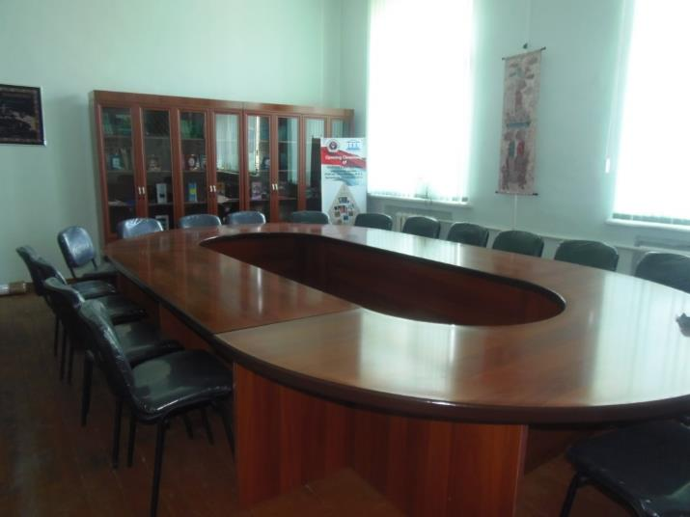
Philology, Foreign languages - namely, English, German, French, Italian, Spanish, Korean, Japanese, Chinese, Arabic and the direction of the translation theory and practice were determined as the basic trends in educational curriculum. Besides above mentioned foreign languages, students have right to chose English, German, French, Arabic, Persian, Korean, Japanese, Chinese, Spanish languages as a second language.

Slide 20
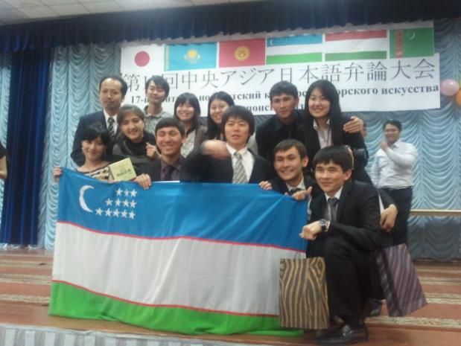
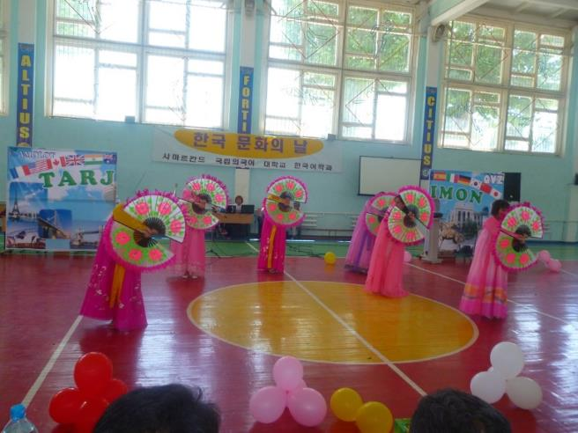
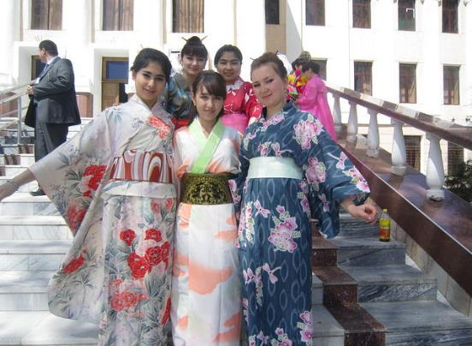
Japanese, Italian, Uzbek, Russian, French, English, Arabic, Turkish, Persian, Korean, Indonesian language and culture centers were established by the initiative of Embassies of foreign countries and equipped with modern teaching technologies.

Slide 21
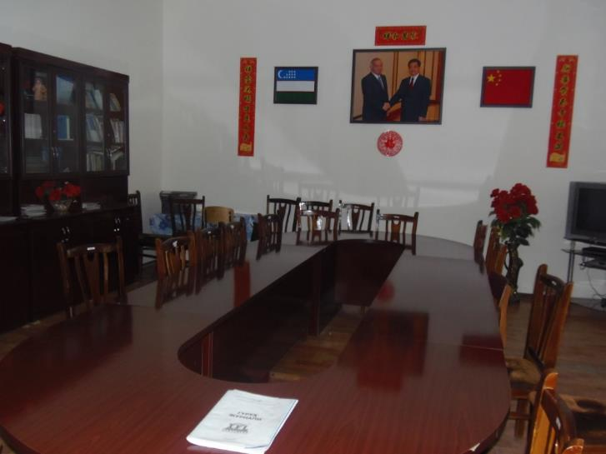
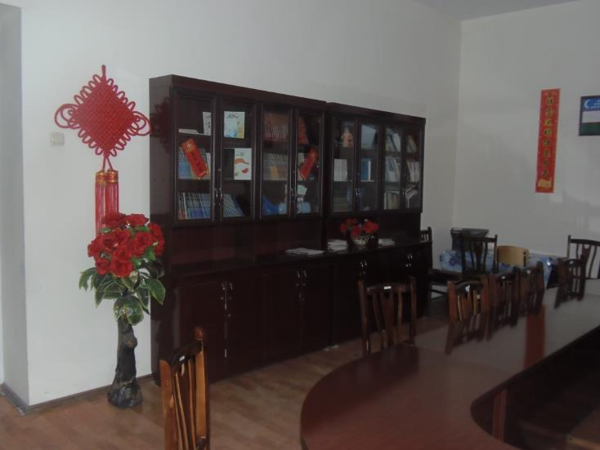
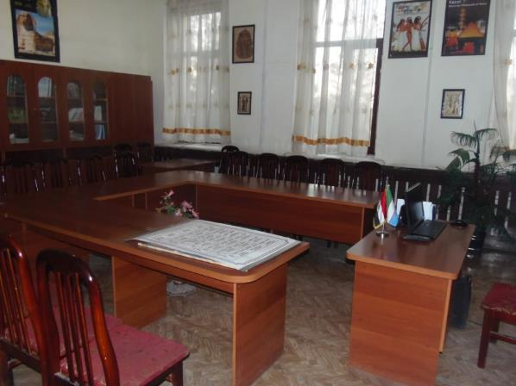
Study rooms, library, network of catering and cultural services as well as Internet Resource Center, the Regional Language Training center, publishing house, Center of Information Technologies, Information Resource center are available at the Institute.

Slide 22
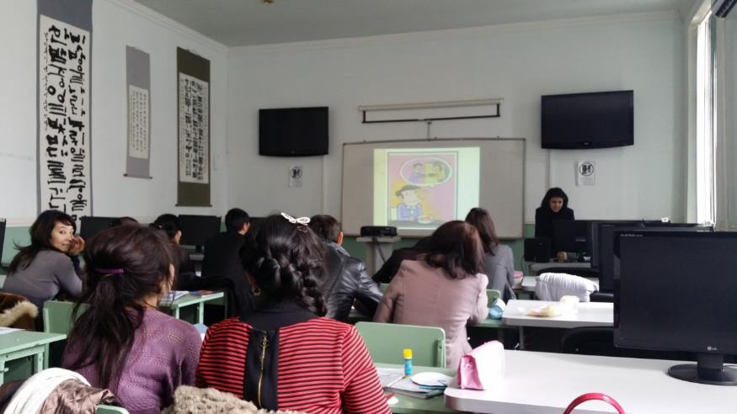
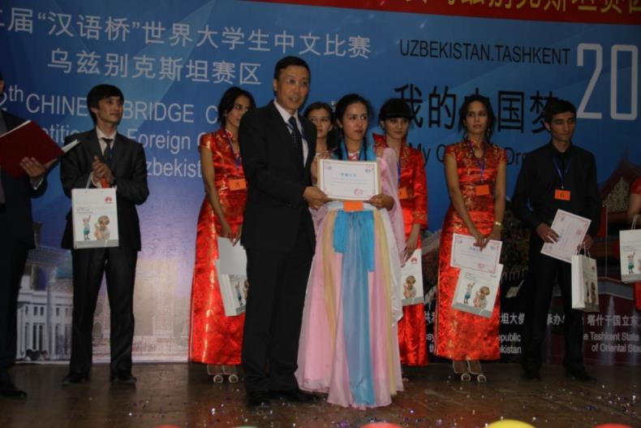
REGIONAL LANGUAGE COURSES
The Regional Language Center of Samarkand State Institute of Foreign Languages offers Uzbek, Russian, English, German, French, Spanish, Italian, Chinese, Korean, Japanese and other language courses for native and international students in individual and group studies. Students have an opportunity to use all facilities and library-materials of the SamSIFL.

Slide 23
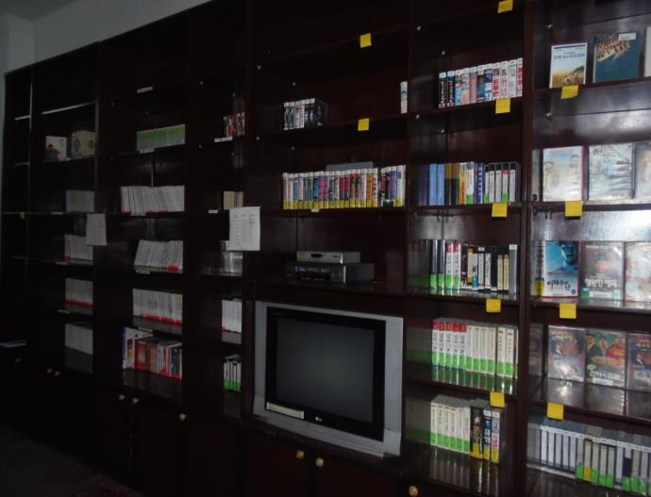
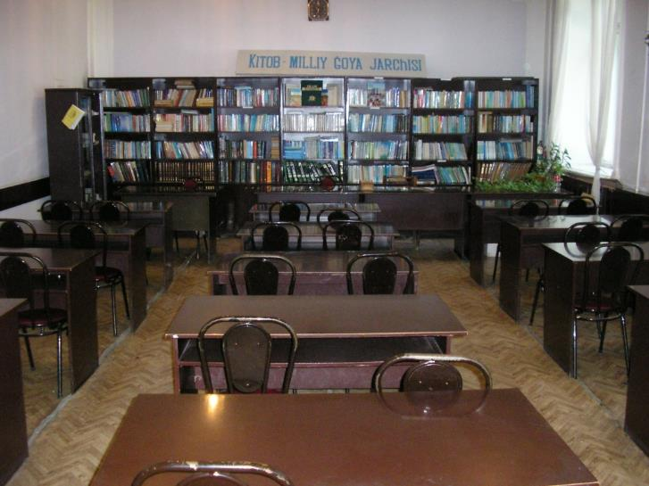
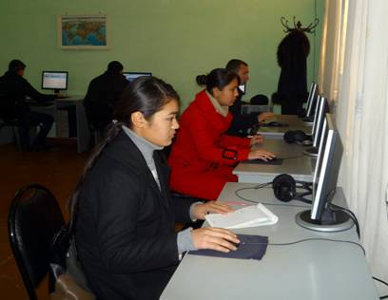
INFORMATION RESOURCE CENTRE
Information Resource Centre of SamSIFL is connected to the internet and includes following branches:
Library
Multimedia Education Centre
Electron Library and Electron Reading Rooms
Reading Room
Educational and Scientific Library

Slide 24
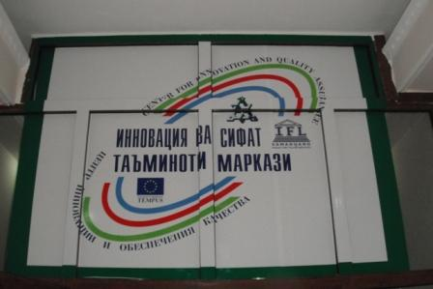
CENTRE FOR INNOVATION AND QUALITY ASSURANCE
This centre consists of the following branches:
Innovation Centre
Quality Assurance Centre
Centre for International Projects and Grants
Scientific Research Centre
MAIN TASKS OF THE CENTER:
Holding seminars and trainings on regular basis on curriculum improvement, considering the experience of European universities;
Rendering methodological and technical support to lecturers in designing, improving and publishing textbooks and handouts with the help of mini-printing-house;
Assuring scientific-methodological, organizational and technological quality of education;
Perfecting the structure and the content of curricula designed for undergraduate and graduate studies, considering the experience of European universities and the requirements of employers;
Monitoring the quality of education;
Informing the education specialists about the standardized procedures of evaluating the quality of education.
Facilitating the methodological, informational and organizational activities of attestation committee, who executes independent quality control of the students’ achievements;
Researching the recent studies on quality assurance for education and summarizing the findings;
Providing organizational and technical support to hold the independent attestation of students and to work out the results;
Performing the interaction and cooperation with departments, centers, chairs and divisions of the institute concerned with quality assurance for education;

Slide 25
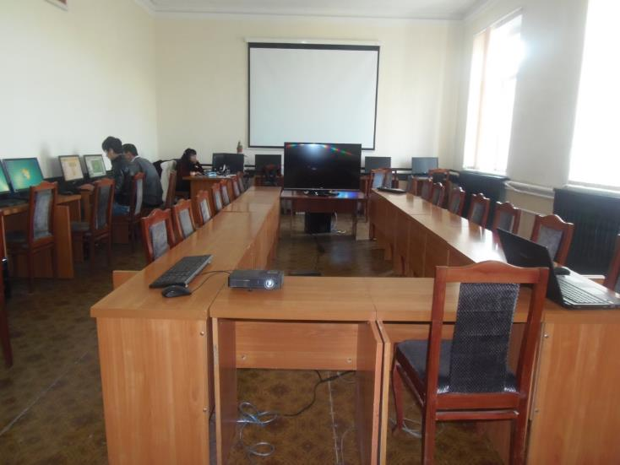
MAIN TASKS OF THE CENTER:
Assisting in preparation of electronic textbooks and methodological complexes through using new IT;
Founding the library of electronic textbooks created by leading European universities and prepare lecturers who can teach them;
Providing the Institute with necessary technical equipment, creating local network linking the center to the information resources of the faculties and departments of the institute;
Promoting distance learning among teachers and students for improving teachers’ methodological skills on Information technologies and obtaining additional knowledge;
Organizing the working groups for creating and updating the database of testing materials (quizzes, tasks, programmed didactic tests etc.) in various fields of study;
Designing the tools for quality control of the testing materials(quizzes, tasks, programmed didactic tests etc.) and working out the technology and procedure of attestation of learners;
Assisting in preparation of electronic textbooks and methodological complexes on multimedia computers;
CENTRE FOR INFORMATION TECHNOLOGY
Information and web-Technology
Distance Learning Courses
Programming and Creation of Information Resources

Slide 26
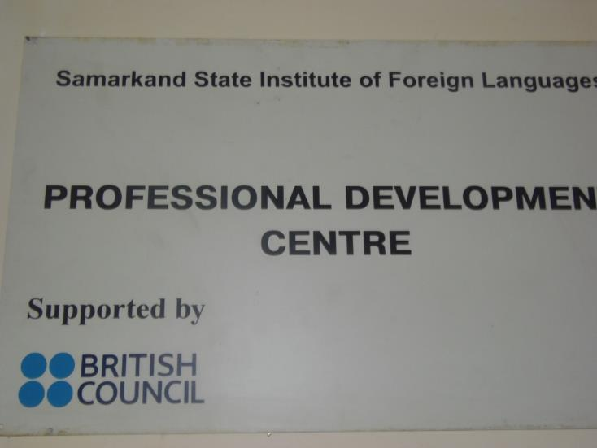
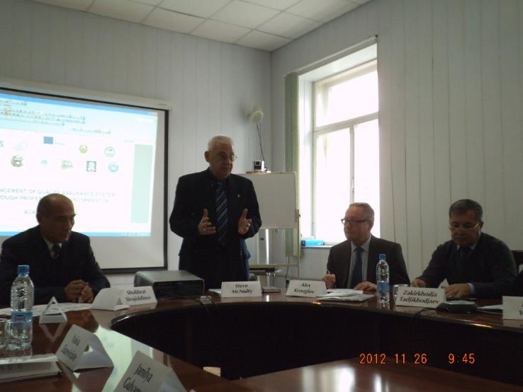
PROFESSIONAL DEVELOPMENT CENTRE
The professional development centre was opened in 2007 by the support of the British Council at SamSIFL within the framework of th у Project INSETT. PDC is the centre where the English Language Teachers can work on their continuous Professional Development. This centre helps English language teachers not only from the institute but also from secondary schools, lyceums and vocational colleges.

Slide 27
Academic calendar:
The academic year starts September 2nd and
finishes July 15th
Classes take place 6 days in a week.
The time-table depends on the days of week and the modules delivered.
Application deadlines:
Starts June 20th till July 20th
Language courses: any time

Slide 28
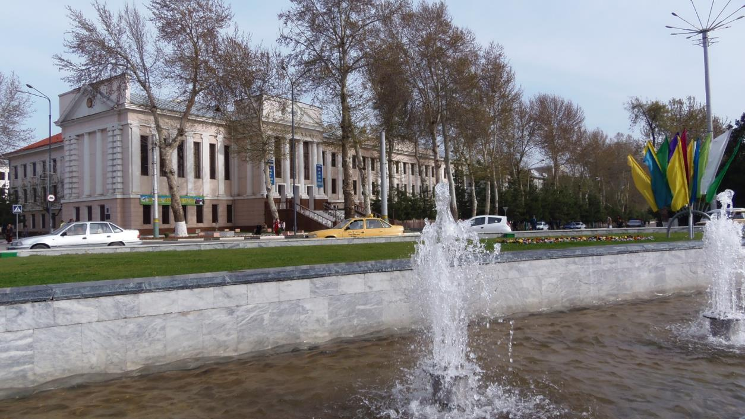
Contact Details:
Str. Bustonsaroy 93.
Samarkand 140104
Republic of Uzbekistan
Samarkand State Institute of Foreign Languages
Tel: + 998 66 233-61-74 Fax: +998662100018
E-mail: intdep@inbox.ru; intdep@mail.samdchti.uz; ssifl_info@mail.ru;
Additional information is available at:
Web-site: www.samdchti.uz

