Slide 1
Université of Caen Contribution to « Developing the Teaching of European Languages: Modernising Language Teaching through the development of blended Masters Programmes »
Tempus Project Kick-off meeting
Tyumen State University
March 3-5 2014
Pierre Larrivée

Slide 2
Université of Caen Presentation
One of the oldest universities in the world, founded twice (1432 by Henry V of England and 1437 by Charles VII of France), with an Arts School since 1437
2h from Paris, 5h from London
Nearly 25k students – 3.8k foreign students
1.6k teaching staff – 237mi overall budget
18 Schools – 7 Departments in the School of Social Sciences, out of which Linguistics

Slide 3
Université of Caen Didactics – Some key facts
Teaching French as A Second Language created as early as 1982, at BA, MSc and PhD levels in the Linguistics Department
Host to external cultural and language services (OFNEC - France-Norway Agency, the Open University, Russian Dept)
Site of the national BELC meetings for 20 years
Summer School Didactique et Langues kicked off in 2013
As a new incarnation of the CEFE (Centre for the Teaching of French to Foreigner), Creation of the University Language Center in 2012 (Carré International), strongly linked to the Linguistics Department
Creation in 2013 of a BSc certificate for TFSL to Adult Migrants

Slide 4
Université of Caen Didactics - Ethos
Based on the analysis of the needs of the learners
Focused on linguistic(s) dimensions (phonological and morphosyntactic analysis skills)
Strenghts in
Academic writing as a means to integrate foreign students
Pragmatics skills (register and interaction)
Teaching methodologies and teaching materials and technologies (ITC)
Teaching practice encouraged through internships available to students Research culture developed through research papers, thesis and
attendance to CRISCO conferences and workshops

Slide 5
CRISCO - Presentation
- Created in 2000
- Research centre
- 23 full members, 18 associate members, 15 PhD students
- 3 main research strands, one of which being didactics of language
Strenghts
- density of thematic cohesion on interpretation of grammar with special reference to French and English
- Important institutionnal interdisciplinary collaboration (Foreign Languages, History, Computing Sciences)
- Tight network of international relations (ILF, Ghent, Neuchâtel ; seminar series and international conferences – Stanford, Yale, Quebec City, Reykjavik, Tel Aviv)
- Mechanisms integrating research and MSc/ teaching
- Important production of applied language analysis tools with social impact and industrial dissemination

Slide 6
Participants
Pierre Larrivée
PhD on semantics of grammar in French ;
Professor of Linguistics and Didactics of French
Director of the CRISCO research center
Co-chair of the Linguistics Departement
• Director of Studies of the the Teaching French as a Second Language MSc programme
• Methodology and Teaching French as a Second Language modules in the MSc, and MSc dissertation supervision
Daria Toussaint
PhD on Chinese grammar ;
Lecturer in the university language center ;
Coordinator of the CRISCO didactics research strand ;
Director of Studies at the university language center ;
• Teaching French as a Second Language modules in the MSc, and MSc dissertation supervision
Anne Prunet
• PhD on the sociolinguistic variation of French through the medium of literature;
• Junior Lecturer in the university language center;
• Applied Teaching French as a Second Language modules in the MSc, and MSc dissertation supervision

Slide 7
Principal involvement of the Caen team in the project
Main roles in the project
1. coordinate the development and implementation of the dissemination strategy;
Question : which group are we targetting, and with which media?

Slide 8
Principal involvement of the Caen team in the project
Main roles in the project
2. oversee launch of websites and promote the project in France;
the project website launched by Dec 2014 in order
to cover the progress and positive results of the project
activity reports; trainers’ network;
relation to teachers’ on-line resources

Slide 9
Principal involvement of the Caen team in the project
Main roles in the project
3. organization of the summative conference (March 2017?)
presentation of national projects
summary of recommendations
publications on the project related issues
research-based and research-eliciting proposals
presentations on project results and papers on language learning

Slide 10
Other involvement of the Caen team in the project
Further actions of the organisation in the project
Lead on development of MA materials, according to expertise;
Oversee information gathering on teacher education policy and practice in France;
Contribute to the development of methodology for MA programme;
Contribute to teacher training programme and MA programme;
Advise on setting up of the e-learning platform and the on-line resource for teachers;
Contribute to the piloting and implementation of the MA programme for French teachers;
Prepare presentations on project results and promote project websites in France;
Prepare and submit financial and narrative reports;
Contribute to trainer network;
Foster internationalisation by development of new projects.

Slide 11
Challenges
• Non-led contributions to the project
Paramount importance for WP leaders to provide advance signposting
Difficulties in travelling to PCs

Slide 12
Challenges
• Financial organisation
Funding transfer, management (identity and rigidity of funding headings?
Availability of administrative support) and reporting : Financial management and reporting operated by the CRISCO (Liliane Docquiert), overseen by the School of Social Sciences (UFR Sciences de l’Homme, Noëlle Gambey) with technical assistance from Noémie Larrouilh (CI)
Following norms to be provided by Aston ?

Slide 13
Challenges
Blended Master deliverable
Degree of anchorage with home institution?
Leading to a diploma?
Challenges : very complex institutional and national approval process; financial sustainability issues. An alternative MOOC model?

Slide 14
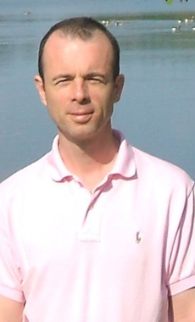
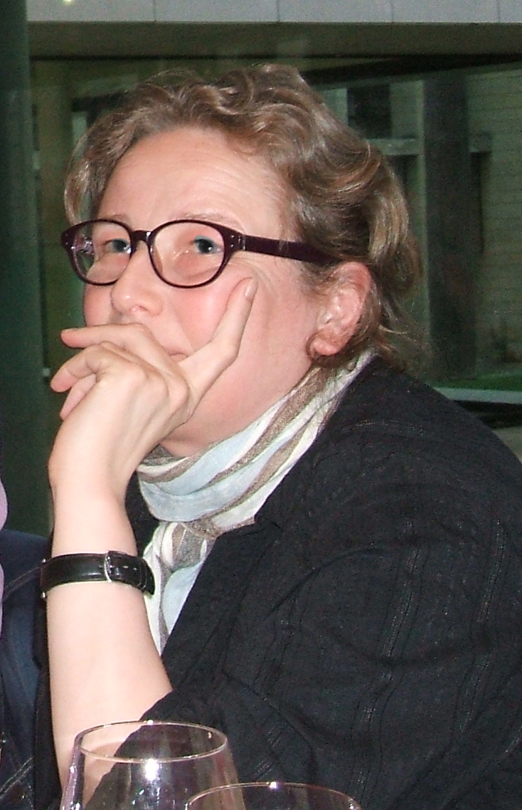
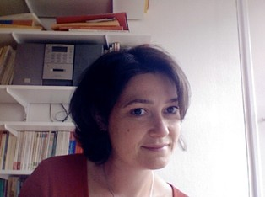
That’s all, folks!
Pierre.Larrivee@Unicaen.fr

